Slide 1
HANDY WATER BAGS

Slide 2

ERT aims to:
raise environmental awareness of water conservation.
develop an easy solution that can be applied in each house to save water.

Slide 3

We have to protect our planet by reducing the amount of water we use. Everyone can do something individually to achieve this.
For example, water is wasted while waiting for the shower or sink to warm up. In order to reduce the water waste, we can capture some of it instead of letting it all run down the drain.
Handy water bags with a special design can be used to capture wasted water while having shower.

Slide 4
The bags
can be hold under a shower head and collect the water until the water becomes warm which is suitable for a shower.
The bags
can be manufactured from a plastic material with high resilience, elasticity and elongation which will be easy to handle and use.

Slide 5
This collected water can be used for other domestic uses such as;
watering plants
cleaning floor
rinsing vegetables and fruits
flushing the toilet

Slide 6
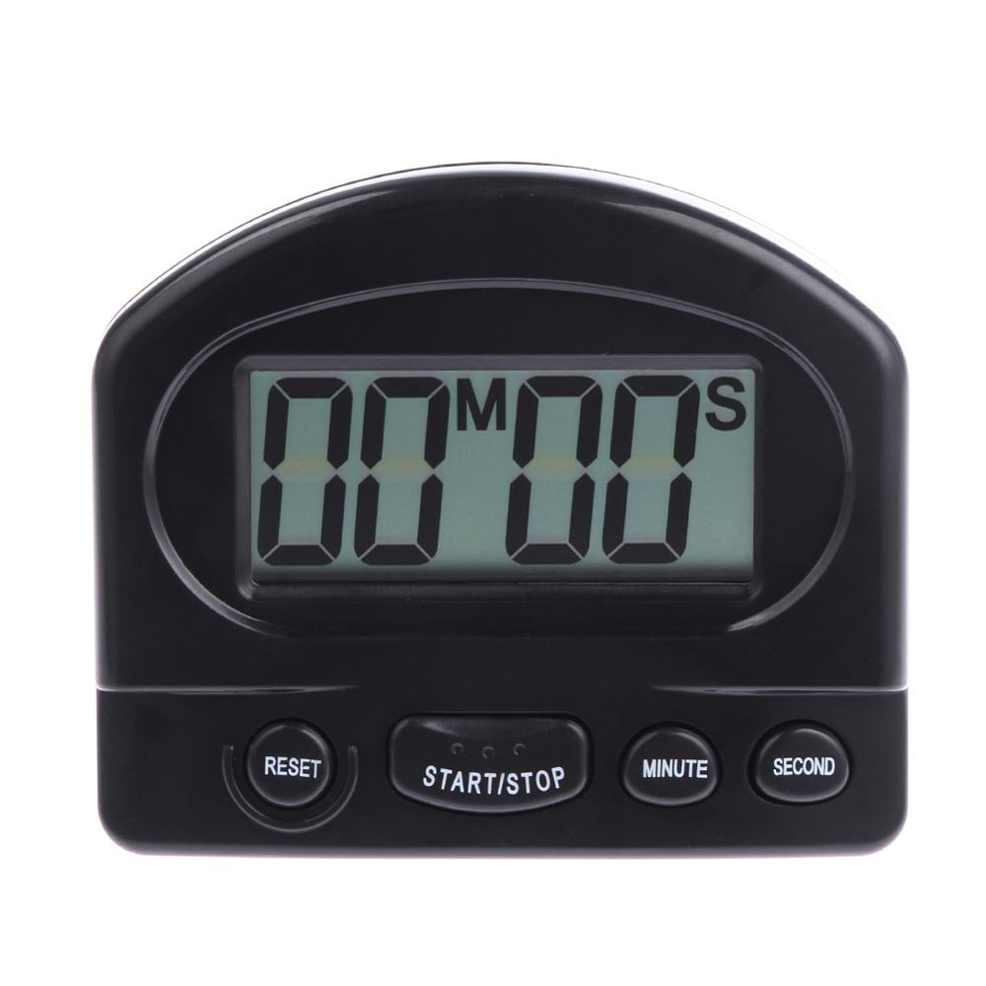
These bags can also have timers that will allow us to limit our shower time because people can stay in the bathrooms for too long without realizing it.

Slide 7
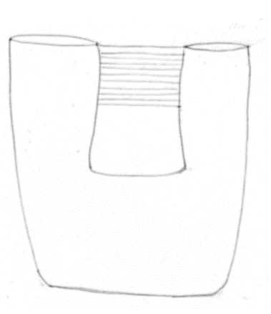

pre-design of handy water bags
water inlet for shower head
water outlet for other uses
400 mm
150 mm
hanger for tap
100 mm
transparent white color
150 mm
optimal filling level
170 mm
400 mm
save each drop
200 mm
transparent blue color
300 mm
shower timer

Slide 8

Similar products may have been designed in the world before ----
---but design and sale of these bags in Turkey, will provide easier access to this product for the people in the nearby region.
An app can also be created to determine the amount of saved water.

Slide 9
OUTCOMES:
These bags will not only save water while waiting for the shower to warm up,
but will also increase the awareness of water conservation.

Slide 10
the value of every wasted water drop will be realized by reminding the importance of water scarcity
with a designed figure and a slogan “save each drop” highlighting this on the top of the bags.
save each drop

